Slide 1
BitCoIN Graph Analysis
By Devanshu Agrawal, James Cate, Kevin Gardner, Chris Shurtleff

Slide 2
Bitcoin
Crypto-currency
Pseudo-anonymous
~$11,000
Silk Road

Slide 3
The Blockchain
Self referencing list of blocks
A set of confirmed transactions
Block confirmed by miners fighting to win a computationally intensive “game”
Structure similar to a graph
Each transaction refers to prior transaction where money was received
What are “best practices”?
Why do they matter?

Slide 4
OUR IDEA
Anonymity lends itself to criminal activity
Two graphs could be made: Address and Transaction
Does the blockchain suggest use of best practices?
Can a graph be used to flag suspicious activity?

Slide 5
Address graph
Nodes are addresses, edges are transactions
Multi-graph
Cycles are permitted
Address Graph
C
R
T
A
B
D
S
U

Slide 6
Input Transactions
Let T be a transaction from address A to B in which A spends transactions R and S
We say R and S are inputs of T
Allow for computation of bitcoin flow
Address Graph
C
R
T
A
B
D
S
U

Slide 7
Transaction Graph
Parent nodes represent input transactions
NOT multigraph
The graph is acyclic
Transaction Graph
R
3
<= 8
T
U
S
5

Slide 8
FLOW
Flow(T, U) to a transaction T from a transaction U is the fraction of bitcoins held in T that were once held in U
Flow(T, X) = 1/(1+2+3)
Flow(T, Y) = 2/(1+2+3)
1
X
1
U
2
2
Y
T
Z
3

Slide 9
Flow (continued)
Flow(X, U) = 1/1
Flow(Y, U) = 2/2
1
X
1
U
2
2
Y
T
Z
3

Slide 10
Flow (continued)
Flow(T, U) = Flow(T, X)*Flow(X, U) + Flow(T, Y)*Flow(Y, U) = 3/6
1
X
1
U
2
2
Y
T
Z
3

Slide 11
Resources
Blockchain.info API
First challenge, API limits
BlockExplorer as block hash archive
Python script calls API
NetworkX processes .csv’s

Slide 12
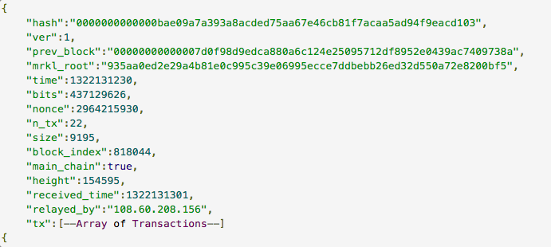
Block JSON

Slide 13
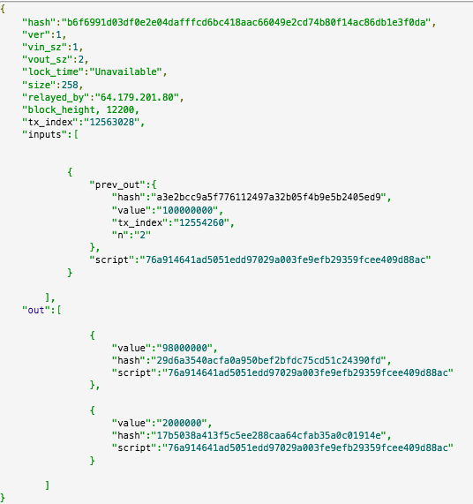
Transaction JSON
Inputs: prev_out (transaction index that contains value)
Special case with mining reward, only have receiving address, only check out here

Slide 14
DATA COLLECTION ScAle
1000-block problems
Collection easy, storage semi-easy, analysis unrealistic
180 megabyte
100-block compromise
Collection easy, storage easy, analysis doable

Slide 15
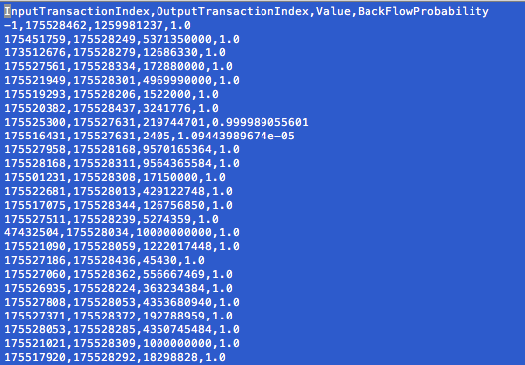
Storage
Edge data into .csv files, kept .log files of block hashes
Input transx index, output transx index, input value, flow probability to head of longest path in graph

Slide 16
GRAPH THEORY CRASH COURSE
Order (number of nodes)
In degree (number of parents)
Out degree (number of children)
Connected components (paths between nodes)
Flow (fraction of bitcoins from another transaction)

Slide 17
Results: An Appetizer
November 2017 Data

Slide 18
Address Graph

Slide 19
Transaction Graph

Slide 20
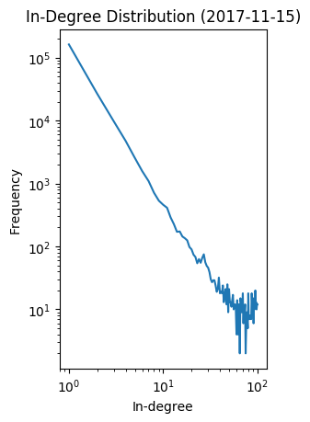
In Degree
Power law distribution

Slide 21
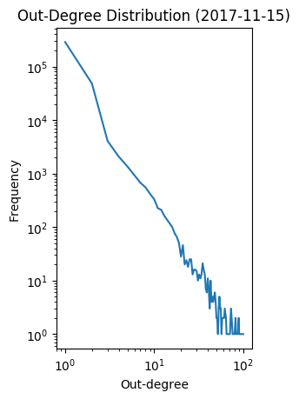
Out Degree

Slide 22
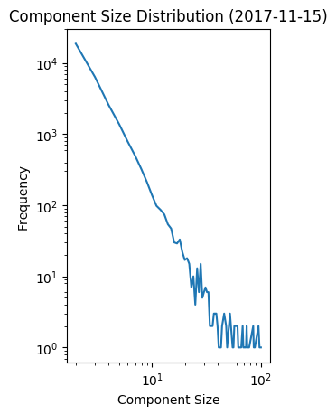
COMPONENTS
Key to security, hints at use of “best practices”

Slide 23
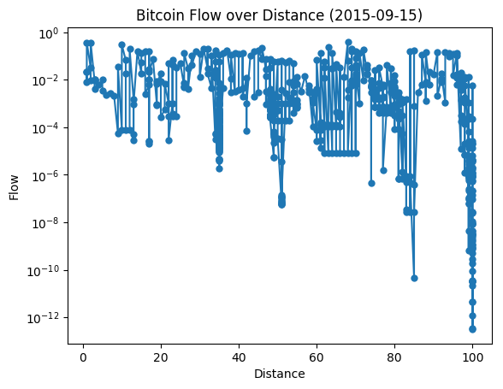
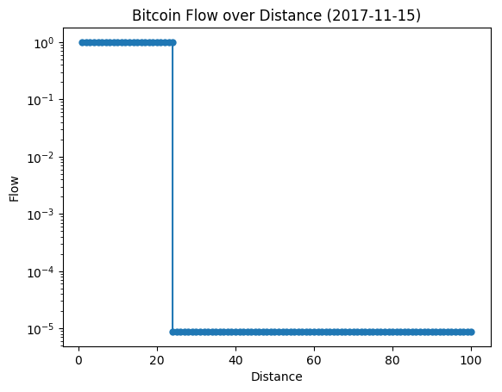
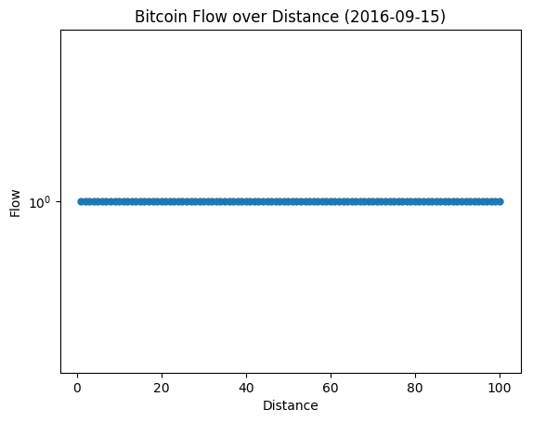
Flow

Slide 24
Results: Main Course
Observations Over Time

Slide 25
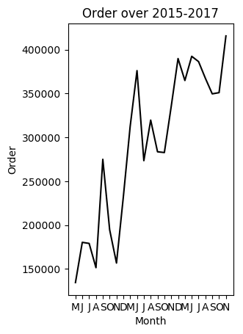
ORDER

Slide 26
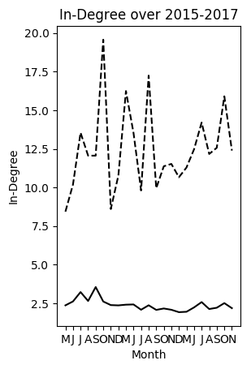
In Degree

Slide 27
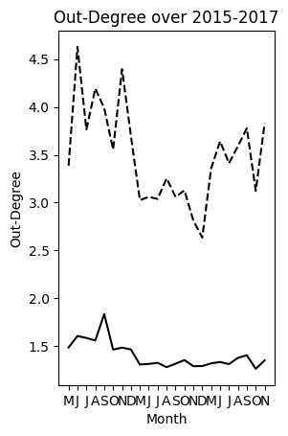
Out Degree

Slide 28
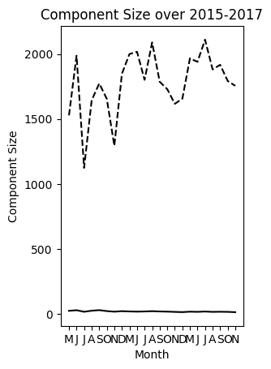
COMPONENTS
Key to security, hints at use of “best practices”

Slide 29
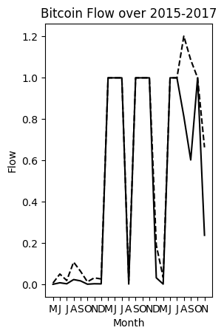
Flow
Erratic
Most likely caused by our calculation method

Slide 30
Conclusions
Bitcoin graph structure has changed little with scale
Power law
Established baseline for outlier detection
Transaction graph is sparse, benefitting security
Best practices are not used by enough people
Flagging individual transactions is very difficult

Slide 31
Future Works
Look more into address and link with transaction graph
Weighting/coloring edges for flow
Scalable technologies, using databases
Stochastic implementations of flow (page-rank)
Collapsing wallets into users
Web scraping to de-anonymize users

